Slide 1
Agile
Andrew McNeil
Software Engineer
March 21, 2019

Slide 2
Introduction
I made this PowerPoint using only information that I have learned from reading books on Software Development. Some of these topics include
Requirements
Design
Test Automation
Continuous Integration
Continuous Delivery
Scrum
Organizational Structure for Agile

Slide 3
How much upfront requirements should be complete at any point in time?
Requirements are fleshed out just in time for teams to start working on functionality to support the requirement^{7,8,12,17}
Requirements are emergent, constantly evolving from client feedback and what you learn about as you work on the project^{14,17}
“Clients don’t know what they want. They know what they don’t want once you make it for them.” –Jez Humble

Slide 4
Design
How much upfront design should be done before coding?
Some guesses
High-level design and low-level design
High-level design only
No design before coding

Slide 5
Design
Only do high-level design before coding^{1,3,4,5,6,7,8,11,14,16}
When doing low-level design prior to coding, your brain is full of little holes¹
As you code up a solution, you learn more about the problem¹
“You can’t create complete requirements or designs up front by simply working longer and harder. Some requirements and design will always emerge once product development is under way; no amount of comprehensive up-front work will prevent that.”⁸

Slide 6
Changes in design
Design is expected to change and evolve based on what we learn by trying to implement it¹⁴
Low level design is constantly evolving throughout a project with refactoring¹
Any time a developer is doing a coding task, they can refactor existing code if it will help their current task¹
Due to frequent changes in low-level design from refactoring, there should be no formal documentation of low-level design⁵
We should let our unit tests act as our low-level design documentation³

Slide 7
When should automated tests be written?
Test Type | When to write
Front-end UI VR Test | Prior to implementation if possible, immediately after implementation otherwise^{5,10,13}
Back-end Functional Test | Prior to implementation^{2,5,7,10,13}
Back-end Unit Test | Prior to implementation^{2,5,7,10,13}
“Code that isn’t tested doesn’t work. If spending time creating acceptance tests before coding slows anything down, it is only slowing the rate at which we are creating code that doesn’t work.”³
The later that automated tests are written, the harder and less efficient it is to write automated tests⁹

Slide 8
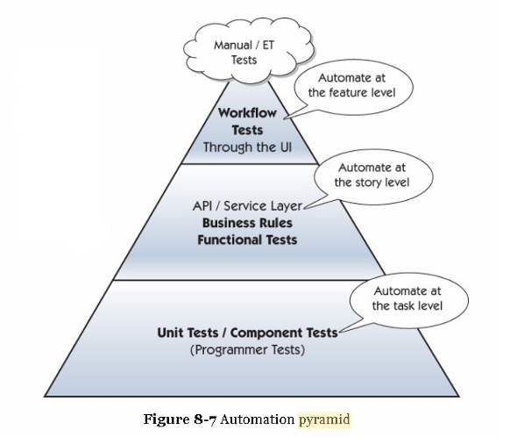
How much of each test type should we write?

Slide 9
Maintain One Version of Code in Production
A complication with client installed software is the many different issues that clients may have¹⁰
This creates a nightmare for support¹⁰
We should aim to keep clients on the same version-the latest version^{6,10}
We should make the upgrade process as painless as possible. Some options:
Have the software check for new versions and prompt the user to upgrade the latest version¹⁰
Download in the back-ground and silently upgrade the next time the application is restarted¹⁰

Slide 10
Maintain One Version of Code in Production
In the case of upgrading, clients commonly defer the option of upgrading in fear that upgrading will break the application¹⁰
If the upgrade process is flaky, then the client is correct to never upgrade¹⁰
If the process is not flaky, then there is no point in providing a choice to the user¹⁰
Giving the user a choice tells them that the developers have no confidence in the upgrade process¹⁰
The correct answer: Download in the back-ground and silently upgrade the next time the application is restarted¹⁰

Slide 11
Canary Releasing
Canary Releasing is a technique to roll out new features to production to a subset of users for testing prior to rolling the version out to everyone¹⁰
A team might think of accomplishing this by maintaining two versions of software-one version with the new feature and one version without the new feature.
However, we should be able to send the same version of software to all clients, with the functionality being hidden for some clients but not others¹⁰
We can accomplish this with feature toggles¹⁰

Slide 12
Feature Toggles
Can be used to turn features on or off for particular users or facilities without requiring a production code deployment¹⁰
Typically done by using a configuration file to store properties that determine which features are visible¹⁰
For example, we may choose to have a new button visible for some clients but not others

Slide 13
Branching
There is a non-linear relationship between lifespan of branches and integration problems¹⁴
There is also a non-linear relationship between the number of branches and integration problems¹⁴
These issues are both solved by Continuous Integration and Pair Programming¹⁴

Slide 14
Continuous Integration
Merging all working developer copies to a shared mainline at least once per day is known as Continuous Integration⁵
Each developer should aim to merge code to master/trunk multiple times per day, once per day minimum^{5,6,10,13,14,15}
Development branches should be short-lived (merged in less than one day after creation)^{10,13,15}
In order to minimize context switching, developers should never have more than one active branch¹⁰
Master should always be releaseable¹⁰
Tasks developing incomplete features should still be merged to master. Feature toggles are used to hide all incomplete features in production while making it visible in development¹⁰

Slide 15
Continuous Review
All code should be approved by at least one teammate before committing to master¹⁴
In addition to having one approval prior to committing to master, someone may optionally review after committing to master¹⁴
Difficult tasks should be pair programmed^{5,6,7}
With pair programming, the partner counts as the second pair of eyes and the task is merged without a formal team-wide review¹⁴
When not pair programming and your code is ready to be reviewed, call a teammate over to your desk to review your code with you before merging (Jez Humble on twitter… I tweeted him this question)

Slide 16
Characteristics of high delivery performance
Research was done on thousands of software organizations on delivery performance.¹⁴ Teams with the highest delivery performance had the following characteristics¹⁴
Fewer than three active branches at a time¹⁴
Branches with short life times (less than a day)¹⁴
No code freezes¹⁴
No stabilization periods¹⁴
Continuous integration and pair programming have both been shown to increase code quality and decreases time to market¹⁴
“Ask a programmer to review ten lines of code, he'll find ten issues. Ask him to do 500 lines and he'll say it looks good.“¹³

Slide 17
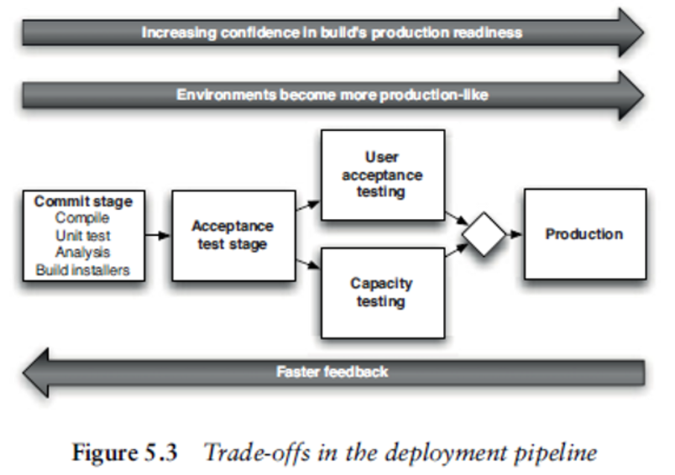
Continuous Delivery
Deploying software into development, test, or production should take two tasks: picking the version and the environment and pressing the “deploy” button¹⁰
In continuous delivery, every code change we make is a release candidate. We may choose to opt in or opt out of releasing the code change¹⁰
If something goes wrong during the release, we should be able to revert the release in seconds¹⁰

Slide 18
Manual Testing in a continuous delivery environment
Contrary to popular belief, manual testing is still necessary to be done prior to each release in a continuous delivery environment. This includes
Exploratory testing¹⁰
User Acceptance Testing¹⁰
The developer should not begin on the next story until the tester is done testing. This is done to prevent context switching under the event any issues are encountered during testing.¹⁰
Instead, the developer should sit with the tester as he/she is testing in case issues are found¹⁰

Slide 19
Biggest contributors to continuous delivery
In 2017, a study was done on software organizations in an attempt to determine which factors were the biggest contributors to continuous delivery¹⁴
Surprisingly, the biggest contributor to continuous delivery was not test automation or deployment automation¹⁴
The biggest contributors to continuous delivery was the ability for teams to
Complete their work without having to communicate with people on another team¹⁴
Make changes to a system without permission of someone outside the team¹⁴
Make changes to the a system without needing another team to make a change to their system¹⁴

Slide 20
The “ultimate configurability”
“It’s almost always better to focus on developing the high-value functionality with little configuration and then add configuration options later when necessary.”¹⁰
“The desire to achieve flexibility may lead to the common antipattern of ‘ultimate configurability’ which is, all too frequently, stated as a requirement for software projects. It is at best unhelpful, and at worst, this one requirement can kill a project.”¹⁰

Slide 21
What to do when our project is behind schedule?
Some ideas
Less attention to quality
Allocate more resources/add members to team
Nothing. We will finish later
Overtime! ☺ ☺ ☺
Reduce scope

Slide 22
What to do when our project is behind schedule?
Worst answer: Less attention to quality^{4,5,6}
Lowering quality lengthens development time^{4,6}
For every dollar gained by cutting quality, it costs $4 to restore it⁵
Best answer: reduce scope⁵
Promotes early feedback⁵
Doesn’t add technical debt⁴

Slide 23
How many projects to work on at a time?
You should aim to work on exactly one project at a time^{2,5,8,11,13}
Working on multiple projects leads to context switching and loss of focus^{8,11,13}
Working on multiple projects reduces the quality of the projects⁸

Slide 24
Should our scrum teams be long lived or short lived?
We should favor long lived scrum teams over short lived scrum teams^{5,6,8,11,13}
Teammates generally work better together after they have been together for longer^{5,8,13}
It is usually more optimal to keep teammates on a scrum team together through the completion of multiple projects as opposed to re-shuffling the teams after each project^{5,13}

Slide 25
Self-Organizing scrum teams
Scrum teams should be self-organizing⁸
A self-organizing scrum team functions as follows:
Most decisions are made by members of the scrum team⁸
The scrum team chooses who will do which work⁸
Leader does not assign work
Determine how the work will be done⁸
People closest to the problem will typically know the most about it¹³

Slide 26
To what extent should each teammate generalize or specialize?
Teammates should posses T-Shaped skills^{8,11,12,13}
Teammates should have deep skills in their preferred functional area⁸
Teammates should have broad skills in multiple other areas in order to reduce the number of hand-offs within the team and outside of the team⁸
The few remaining handoffs should primarily be handoffs to people within the team which are significantly faster and cheaper than handoffs to people outside of the team¹¹

Slide 27
Additional Scrum team recommendations
5-7 members⁸
2-3 week sprints⁸
Cross-functional⁸

Slide 28
Communication between teams
Teams should be assembled such that the number of communication paths between teams is minimized^{5,13}
Teams should be able to independently develop and deploy code to production without requiring handoffs to other teams¹³
Teams should be able to quickly and independently deliver value to the customer¹³
Avoid attending recurring scrum meetings of other teams (retros, demos, planning, etc)⁵
Communication between teams shouldn’t revolve around specific details at the implementation level. It should revolve around discussing higher-level shared goals and how we can achieve those goals¹⁴

Slide 29
Ticketing Hell
When development and operations are split out to different teams, the process often results in ‘ticketing hell’, having to raise a series of tickets in order to get anything done^{10,13}
Solutions
Embed operations members onto the development team^{13,15}
Assign liaisons between operations and development members¹³
Create self-service capabilities¹³
“It’s okay for people to be dependent on our tools, but it’s important that they don’t become dependent on us.”¹³

Slide 30
Potentially Shippable Product Increments
In scrum, teams create potentially shippable product increments each sprint^{5,8}
This means that code is fully
Tested^{5,8}
Documented^{5,8}
Integrated⁵

Slide 31
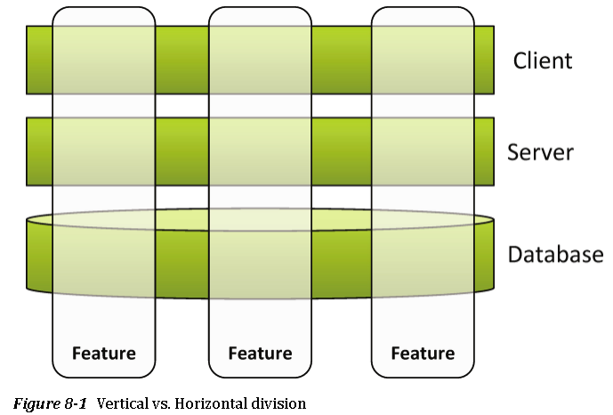
Vertical vs Horizontal division
Features generally involve multiple different layers⁹
Scrum asks that teams work on a small portion of each layer with the code fully integrated each sprint⁹

Slide 32
Feature Teams
Feature teams are cross-functional and teams that can work on end to end features with minimal hand-offs to other teams⁸
A feature team will typically work on multiple components in order to complete the feature⁸

Slide 33
Component Teams
Component teams
own a particular component⁸
Components are re-usable assets providing common functionality needed to implement features
Form on the belief that a team of experts who are trusted to make safe changes in an area should own that area⁸
Results in people only working in areas that they are specialized in⁸

Slide 34
Feature teams or Component Teams?
Component teams pose the following problems
Most features result in code changes in multiple components¹⁰
Multiple teams must communicate together in order to complete a feature⁸
Component teams have to deal with competing requests from other teams while at the same time completing everything by the appropriate time⁸
Commonly defers integration until the very end due to being on different teams
Increases the number of failure points from one (feature team) to multiple (number of component teams)⁸
Longer lead times¹³
Scrum favors feature teams over component teams^{8,10,11,13}
Organizations should contain a large number of feature teams and a small number of component teams^{8,10}

Slide 35
Summary
Requirements and design are emergent and are constantly evolving
Keep clients on the same version of code-the latest version
Merge all working developer copies into a shared mainline several times per day
Work on exactly one project
Develop T Shaped skills
Minimize handoffs
Favor organizing around end to end features over organizing around components

Slide 36
Sources
[1] Fowler, Martin. Refactoring: Improving the Design of Existing Code. Boston, MA, USA: Addison-Wesley, 1999.
[2] The Clean Coder: A Code of Conduct for Professional Programmers. Prentice Hall, 2011.
[3] Beck, Kent. Test Driven Development By Example. 2002.
[4] Sterling, Chris. Managing Software Debt, Building for Inevitable Change. Addison-Wesley, 2010.
[5] Cohn, Mike. Succeeding With Agile: Software Development Using Scrum. Addison-Wesley, 2013.
[6] Beck, Kent. Extreme Programming Explained, Embrace Change . Addison-Wesley, 2012.
[7] Cohn, Mike. User Stories Applied For Agile Software Development. Addison-Wesley, 2004.
[8] Rubin, Kenneth. Essential Scrum: A Practical Guide To The Most Popular Agile Process. Addison-Wesley, 2013.
[9] Axelrod, Arnon. Complete Guide to Test Automation. Apress, 2018
[10] Humble, Jez and Farley, David. Continuous Delivery: Reliable Software Releases Through Build, Test And Deployment Automation. Addison-Wesley, 2010.
[11] Narayan, Sriram. Agile IT Organization Design. Pearson Education, 2015.
[12] Gregory Janet, and Cirspin, Lisa.More Agile Testing: Learning Journeys For The Whole Team. Addison-Wesley, 2014.
[13] Kim, Gene, et al. The DevOps Handbook: How to Create World-Class Agility, Reliability, and Security in Technology Organizations. IT Revolution, 2016.
[14] Forsgren, Nicole, et al. Accelerate, The Science of Lean Software and DevOps: Building and Scaling High Performing Technology Organizations. IT Revolution, 2018.
[15] Wolff, Eberhard. A Practical Guide to Continuous Delivery. Addison-Wesley, 2017.
[16] Bain, Scott. Emergent Design: The Evolutionary Nature of Professional Software Development. Addison-Wesley, 2008.
[17] Goldstein, Ilan. Scrum Shortcuts without Cutting Corners, Agile Tactics, Tools, & Tips. Addison-Wesley, 2013.

Slide 37
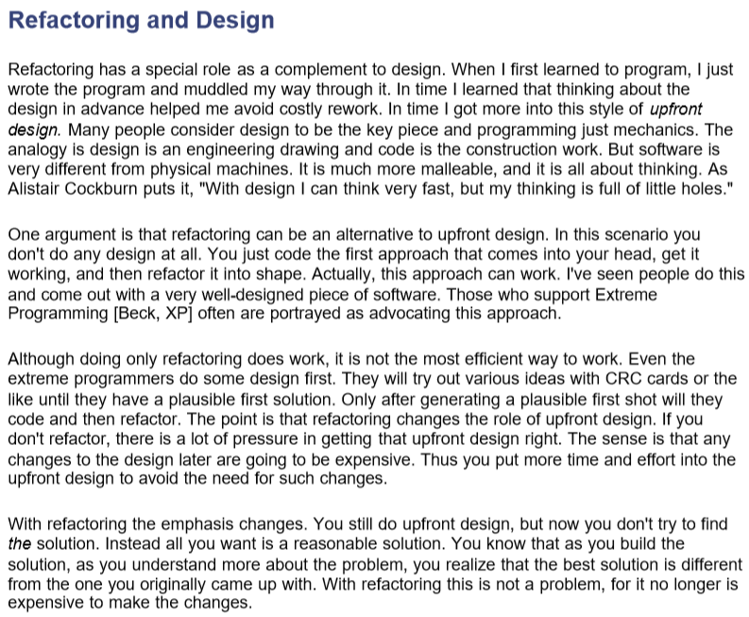
Fowler on how much design up front before coding
Fowler, Martin. Refactoring: Improving the Design of Existing Code. Boston, MA, USA: Addison-Wesley, 1999.

Slide 38
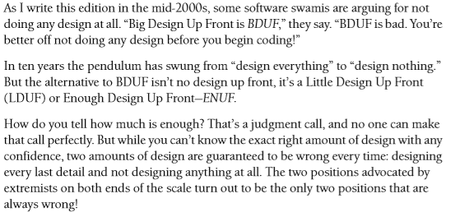
Kent Beck on how much design up front before coding
[3] Beck, Kent. Test Driven Development By Example. 2002

Slide 39
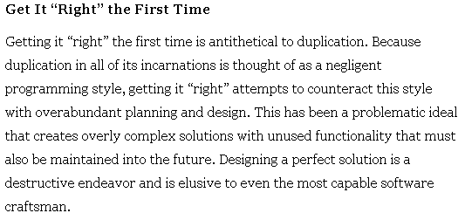
Chris Sterling on up front design
[4] Sterling, Chris. Managing Software Debt, Building for Inevitable Change. Addison-Wesley, 2010.

Slide 40
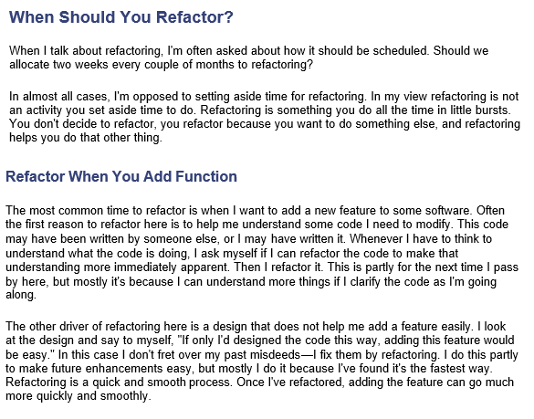
Martin Fowler on when to refactor
[1] Fowler, Martin. Refactoring: Improving the Design of Existing Code. Boston, MA, USA: Addison-Wesley, 1999.

Slide 41
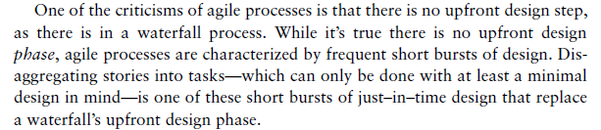
Mike Cohn on upfront design
[7] Cohn, Mike. User Stories Applied For Agile Software Development. Addison-Wesley, 2004.

Slide 42
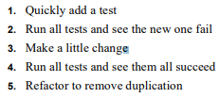
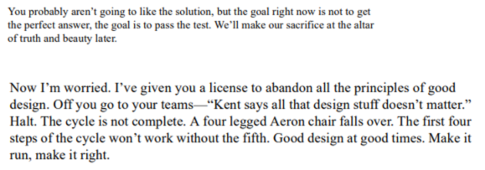
Kent Beck on TDD and Design
Kent Beck in regards to step 3. above

Slide 43
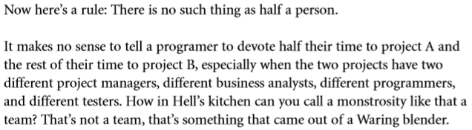
Uncle Bob on the number of projects to work on at a time
The Clean Coder: A Code of Conduct for Professional Programmers. Prentice Hall, 2011.

Slide 44
Mike Cohn on working on multiple projects at a time
“Put people on one project. Individuals assigned to work on multiple projects inevitably get less done. Multitasking—attempting to work on two projects or two things at once— solved. Really, though, in many cases the problem has been made worse.”
[5] Cohn, Mike. Succeeding With Agile: Software Development Using Scrum. Addison-Wesley, 2013.

Slide 45
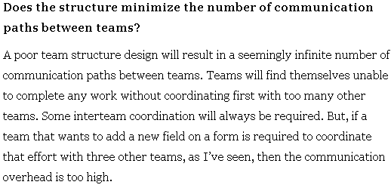
Mike Cohn on communication between teams
[5] Cohn, Mike. Succeeding With Agile: Software Development Using Scrum. Addison-Wesley, 2013.

Slide 46
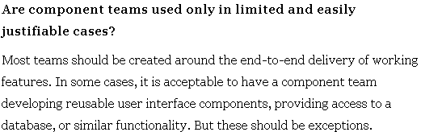
Mike Cohn on feature vs component teams
[5] Cohn, Mike. Succeeding With Agile: Software Development Using Scrum. Addison-Wesley, 2013.

Slide 47
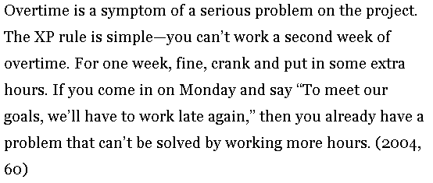
Kent Beck on Overtime
[6] Beck, Kent. Extreme Programming Explained, Embrace Change . Addison-Wesley, 2012.

Slide 48
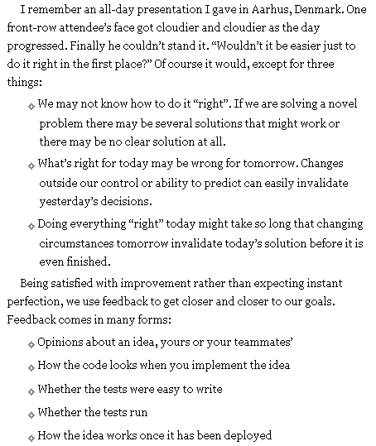
Kent Beck on trying to “get it right” the first time
[6] Beck, Kent. Extreme Programming Explained, Embrace Change . Addison-Wesley, 2012.

Slide 49
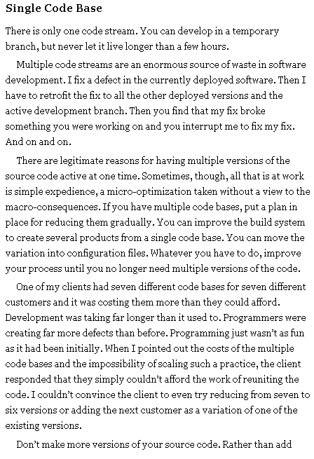
Kent Beck on maintaining one version of code
[6] Beck, Kent. Extreme Programming Explained, Embrace Change . Addison-Wesley, 2012.

Slide 50
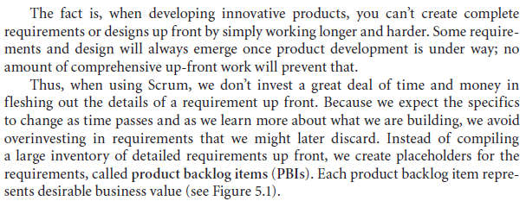
Kenneth Rubin on upfront requirements and upfront design
[8] Rubin, Kenneth. Essential Scrum: A Practical Guide To The Most Popular Agile Process. Addison-Wesley, 2013.

Slide 51
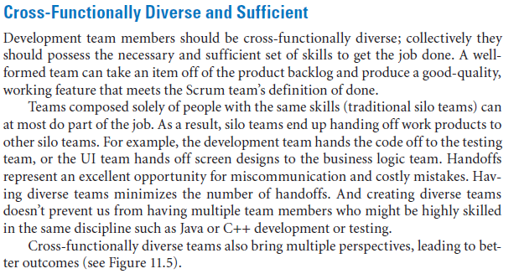
Kenneth Rubin on cross-functional teams
[8] Rubin, Kenneth. Essential Scrum: A Practical Guide To The Most Popular Agile Process. Addison-Wesley, 2013.

Slide 52
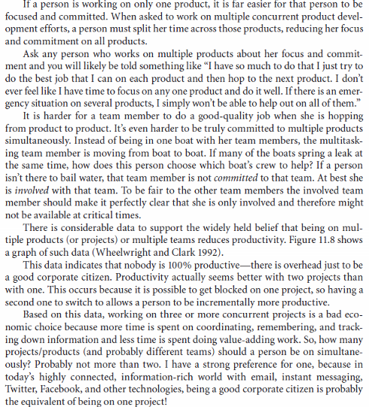
Kenneth Rubin on working on multiple projects
[8] Rubin, Kenneth. Essential Scrum: A Practical Guide To The Most Popular Agile Process. Addison-Wesley, 2013.

Slide 53
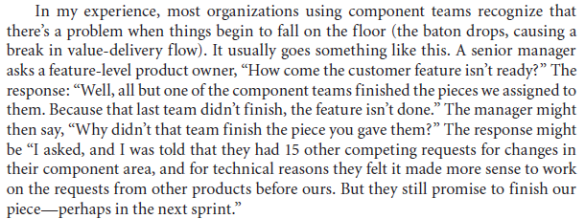
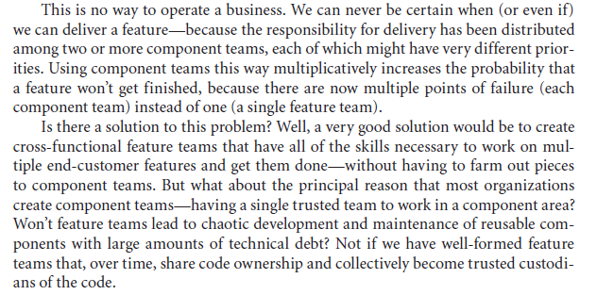
Kenneth Rubin on feature teams vs component teams
[8] Rubin, Kenneth. Essential Scrum: A Practical Guide To The Most Popular Agile Process. Addison-Wesley, 2013.

Slide 54
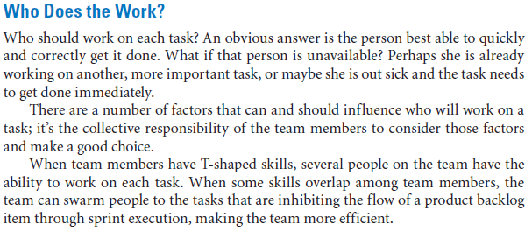
Kenneth Rubin on T Shaped skills
[8] Rubin, Kenneth. Essential Scrum: A Practical Guide To The Most Popular Agile Process. Addison-Wesley, 2013.

Slide 55
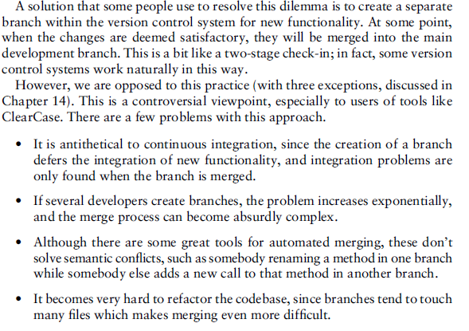
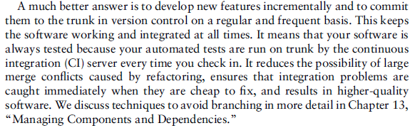
Jez Humble on branching
[10] Humble, Jez and Farley, David. Continuous Delivery: Reliable Software Releases Through Build, Test And Deployment Automation. Addison-Wesley, 2010.

Slide 56
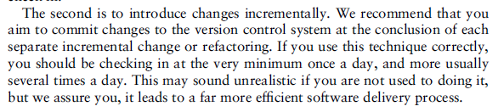
Jez Humble on how frequent to merge to master
[10] Humble, Jez and Farley, David. Continuous Delivery: Reliable Software Releases Through Build, Test And Deployment Automation. Addison-Wesley, 2010.

Slide 57
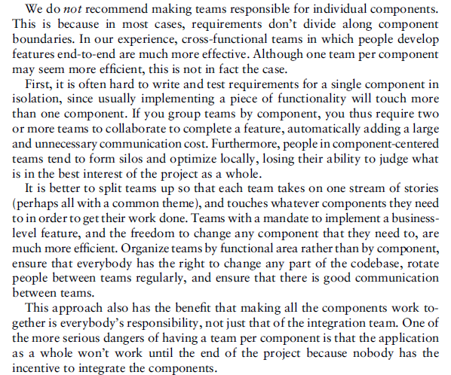
Jez Humble on component teams
[10] Humble, Jez and Farley, David. Continuous Delivery: Reliable Software Releases Through Build, Test And Deployment Automation. Addison-Wesley, 2010.

Slide 58
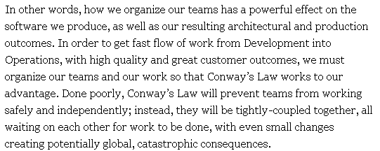
Jez Humble on Conway’s Law
[13] Kim, Gene, et al. The DevOps Handbook: How to Create World-Class Agility, Reliability, and Security in Technology Organizations. IT Revolution, 2016.

Slide 59
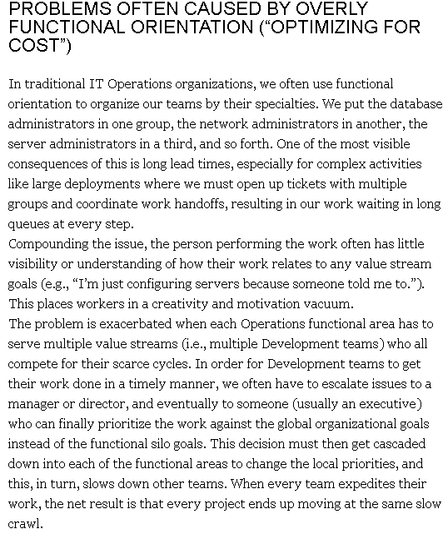
Jez Humble on overly functional orientation
[13] Kim, Gene, et al. The DevOps Handbook: How to Create World-Class Agility, Reliability, and Security in Technology Organizations. IT Revolution, 2016.

Slide 60
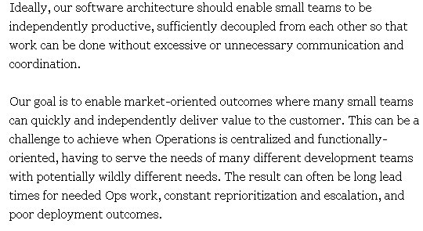
Jez Humble on cross-team communication
[13] Kim, Gene, et al. The DevOps Handbook: How to Create World-Class Agility, Reliability, and Security in Technology Organizations. IT Revolution, 2016.

Slide 61
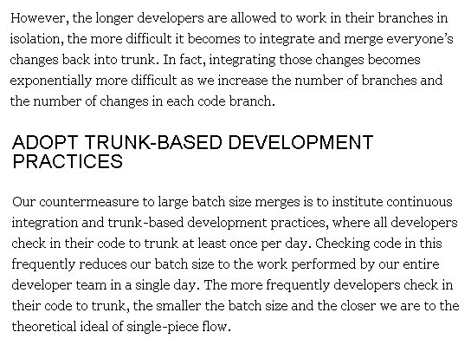
Jez Humble on Trunk Based Development
[13] Kim, Gene, et al. The DevOps Handbook: How to Create World-Class Agility, Reliability, and Security in Technology Organizations. IT Revolution, 2016.

Slide 62
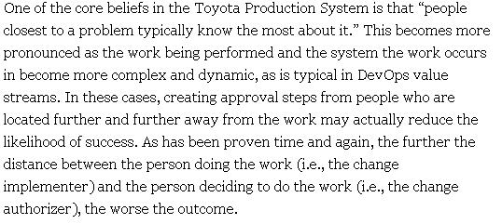
Jez Humble on making decisions where the knowledge is
[13] Kim, Gene, et al. The DevOps Handbook: How to Create World-Class Agility, Reliability, and Security in Technology Organizations. IT Revolution, 2016.

Slide 63
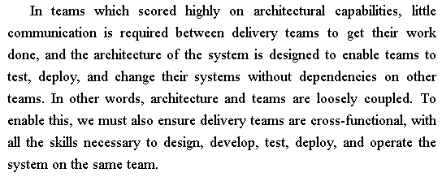
Jez Humble on architectural capabilities
[14] Forsgren, Nicole, et al. Accelerate, The Science of Lean Software and DevOps: Building and Scaling High Performing Technology Organizations. IT Revolution, 2018.

Slide 64
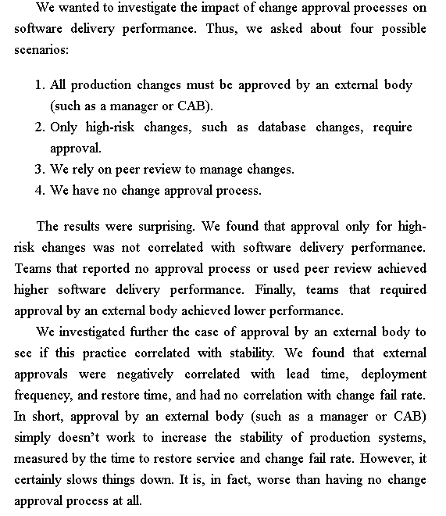
Jez Humble on the impact of change approval boards on software delivery performance

